Slide 1
Information Visualization Visualization Sketch
G01-A
70493 – Tiago Nascimento
76102 – Miguel Cruz
76394 – Daniel Trindade

Slide 2
Visual encoding
01

Slide 3

Visual Encoding – 1
Ranks

Slide 4
Visual Encoding – 1
Ranks – bar chart
Type:
Length – amount of medals or the medals/population coefficient
Position – one for each country

Slide 5
Visual Encoding – 1
Ranks
Visual Encoding:
USA
92
China
75
Italy

Slide 6
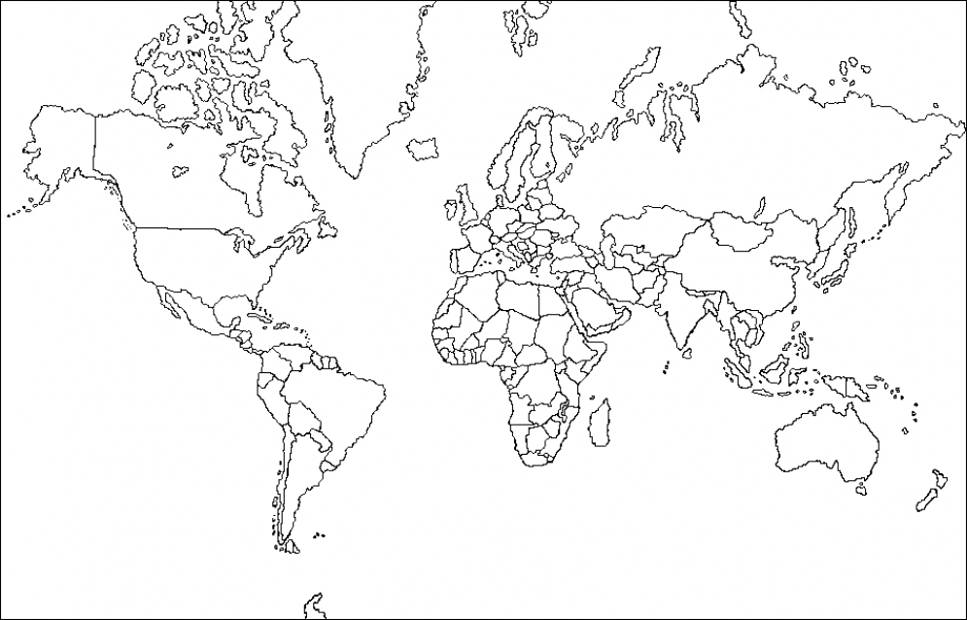
Visual Encoding – 2
A scatter plot over a map

Slide 7
Visual Encoding – 2
A map
Type:
Size/Area – amount of medals or the medals/population coefficient
Position – corresponds to the location of the country on the map

Slide 8
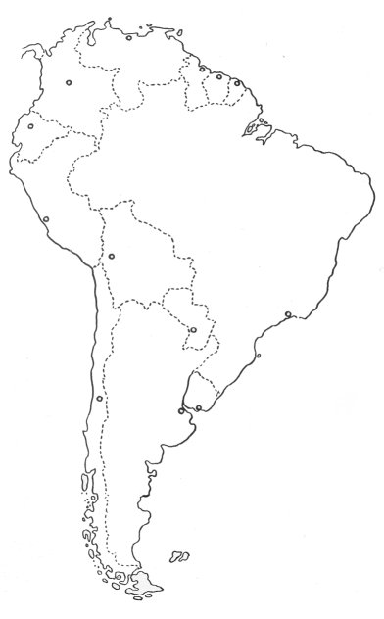
Visual Encoding – 2
A map
Visual Encoding:
2
32
14

Slide 9

Visual Encoding – 3
Compare results

Slide 10
Visual Encoding –3
Compare results

Slide 11
Visual Encoding – 3
Compare results - additions
Type:
Colors – to distinguish the two countries

Slide 12
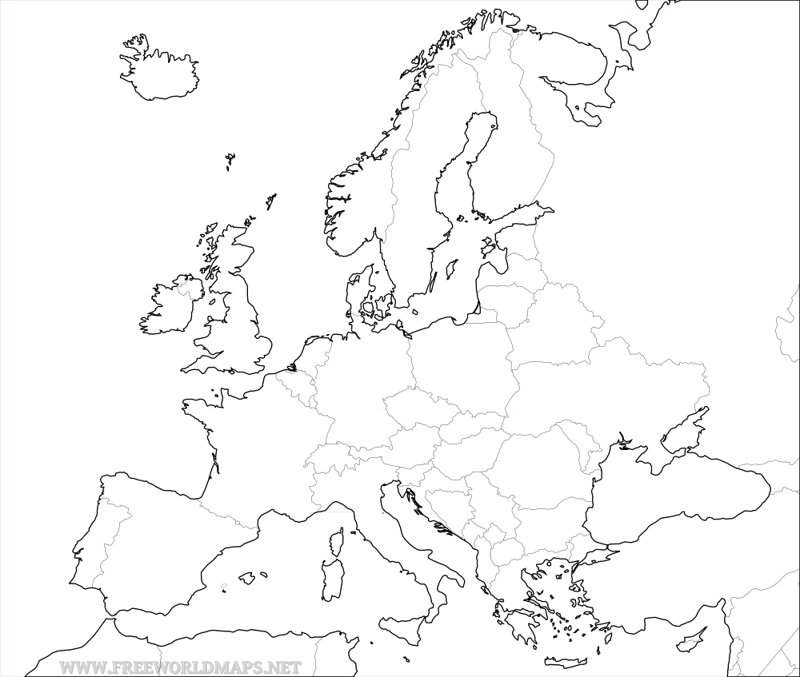
Visual Encoding – Item 3
Compare result
Visual Encoding:
VS
Brazil
Portugal

Slide 13
Visual Encoding – Item 3
Compare result
Visual Encoding:
All Sports
94
32
Judo
17
2
…

Slide 14
IDIOM – tasks/questions mapping
02

Slide 15
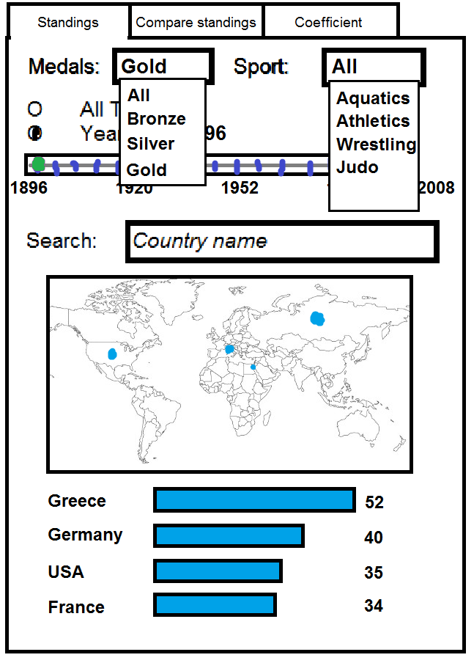
What countries had the most gold medalists in the first games, in 1896?
First we filter the information we want

Slide 16
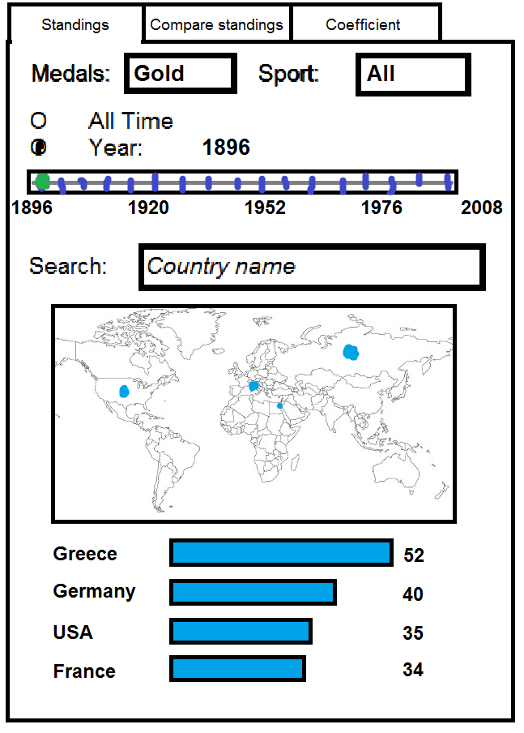
What countries had the most gold medalists in the first games, in 1896?
Then for each filter the information dynamically changes

Slide 17
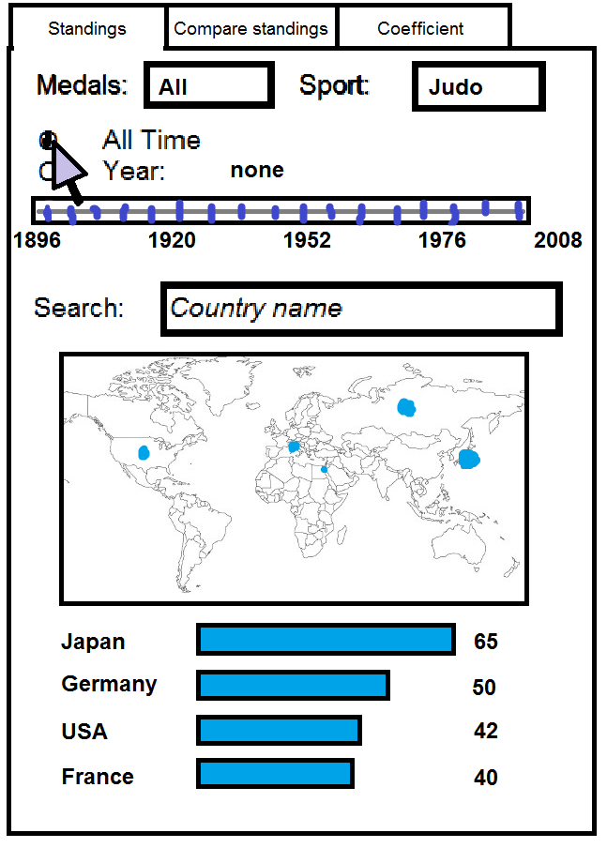
What country has the most medalists in Judo?
Again using the filters…

Slide 18
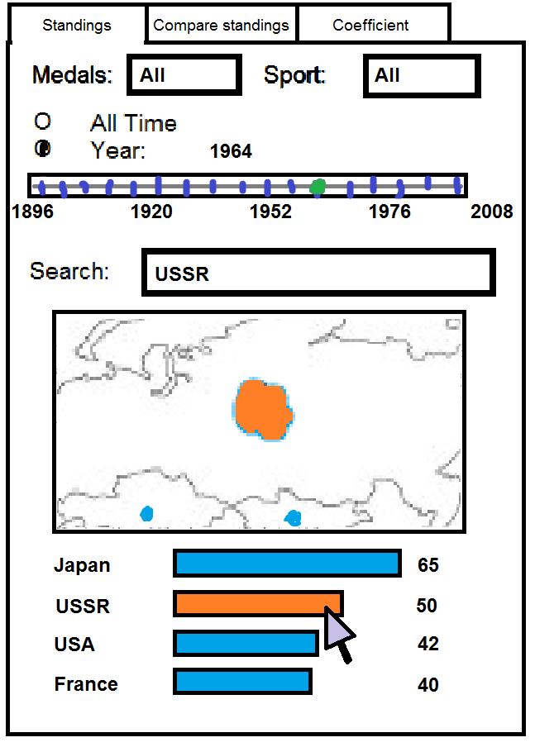
What are the standings of the USSR in 1964?
Again using the filters…

Slide 19
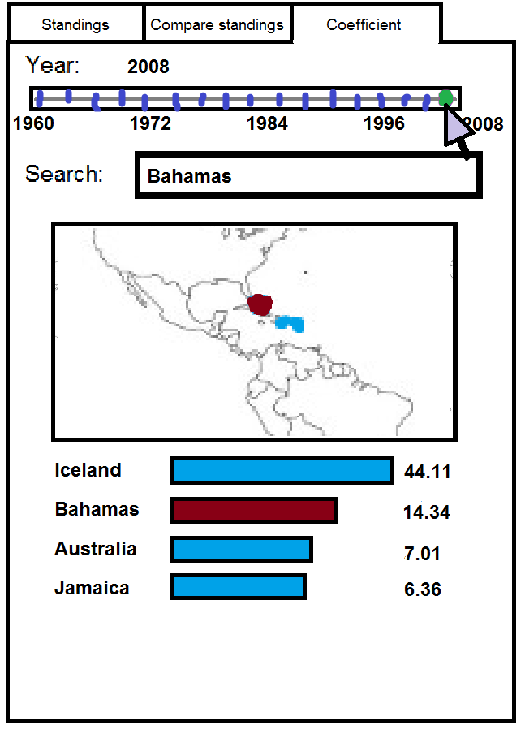
See the countries with the most medalists per capita in 2008.
Using the Coefficient tab (medalists/population)

Slide 20
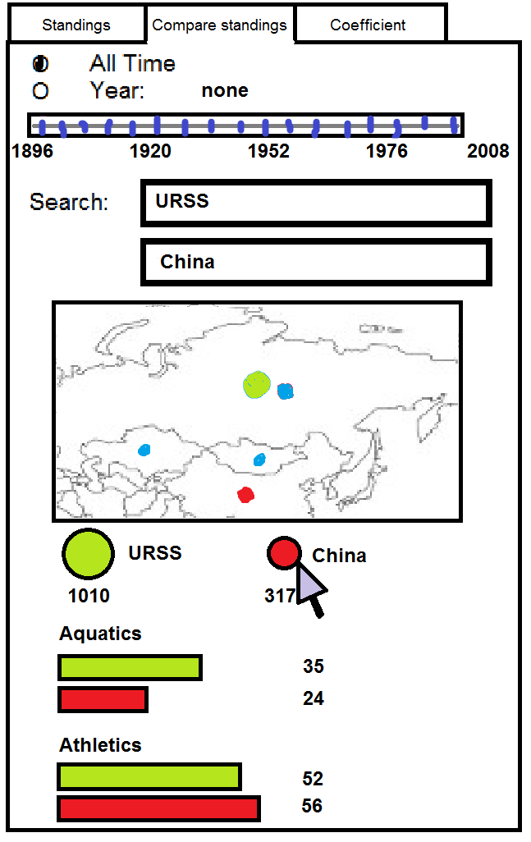
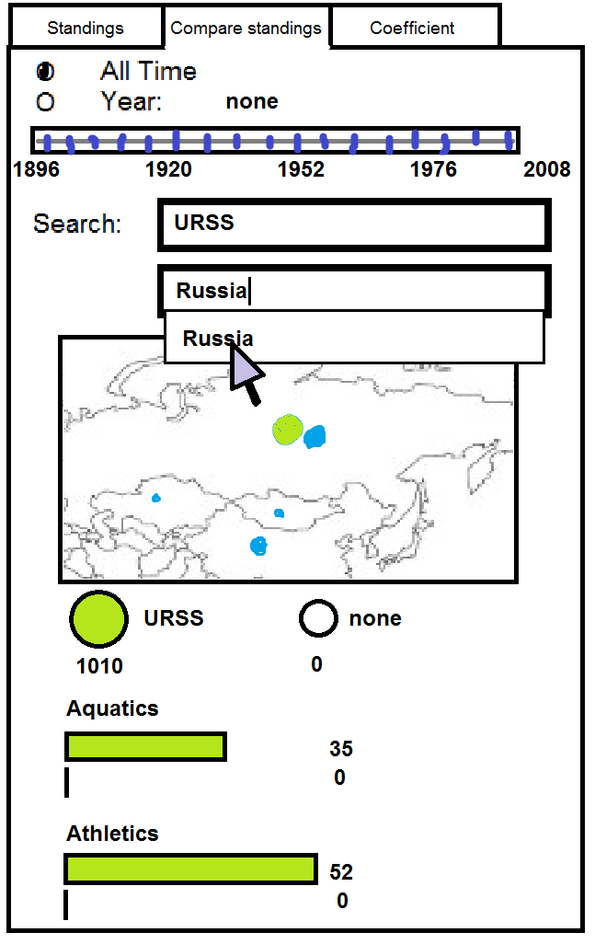
How do the USSR and Russia’s cumulative scores compare?
Using the Compare Standings tab
Remove China
Pick Russia

Slide 21
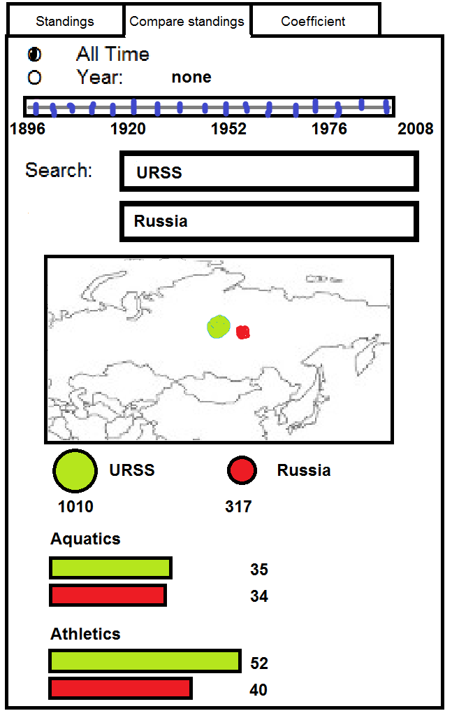
How do the USSR and Russia’s cumulative scores compare?
Using the Compare Standings tab
Get the results

